Slide 1

Under Guidance of
Prof. S.K.Bondhopadhyay
Sudipta Paul
Roll no. : 91/CIS/091014
Registration no: 0054377 Of 2006-07

Slide 2
What is Plastic Surgery?
Plastic surgery is a medical specialty concerned with the correction or restoration of form and function of different body part. Though cosmetic is the best-known kind of plastic surgery, most plastic surgery is not cosmetic: plastic surgery includes many types of reconstructive surgery, and the treatment of burns.

Slide 3
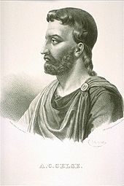
A little bit of History
Aulus Cornelius Celsus, who lived in the first century AD, described plastic surgery of the face, using skin from other parts of the body.
So it is practiced from the ancient age.

Slide 4
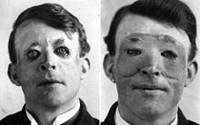
1st Formal Plastic Surgery
Walter Yeo, a British soldier, is often cited as the first known person to have benefited from plastic surgery. It happened in 1917. performed by Sir Harold Gillies.

Slide 5
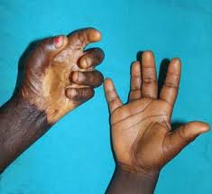
Why it becomes so popular?
It can reconstruct the human body part which has a ugly scar due to some accident such as burn impression.

Slide 6
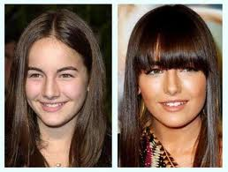
Reason of popularity
Some people may not be satisfied with their natural face. Plastic surgery may be a solution for their frustration.

Slide 7
What happens in Face Fusion?
It replaces an individual’s facial feature with corresponding features of another individual may be different skin colour. The resulting face may have discontinuities and may not look natural.
So only replacement operation is not the solution.

Slide 8
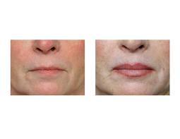
Example of face fusion
Here only the lip part is replaced. Left one is before and right one is after. In this type of face fusion the total face must look natural otherwise discontinuities will be visible.

Slide 9
Virtual Plastic Surgery
It is the process by which the resultant face should appear after the surgery.
This virtual surgery process helps a lot in removing the discontinuity of the face that may occur if the face is not predicted.

Slide 10
Implementation
It has five modules:
Face detection
Feature detection
Replacement
Blending
Shifting

Slide 11
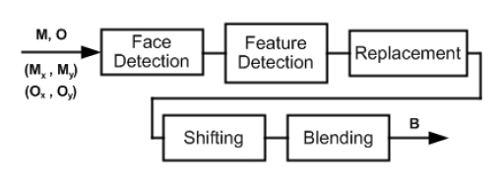
Modules of the Face Fusion

Slide 12
Face Detection
User gives input by clicking the coordinate of the nose tip belonging to the face of interest.
Previous diagram shows the input.
M is the model image, O is the original image, (M_{x} ,M_{y} ) is the coordinate of the tip of the nose for the model image and (O_{x} , O_{y} ) is same for original image.
A template is placed on the face which is enlarging in small interval.

Slide 13

Face Detection
Following transformation on the image is performed 1st.
F: M^{m*n*3} → T^{m*n*1}
such that
T(i, j)=

Slide 14
Face Detection
Here M(i,j,k) gives the values of the pixel in the ith row & jth column.
T is the resulting image.
Value subtracted is the mean RGB value for the 10X10 pixel array centered around nose tip.

Slide 15
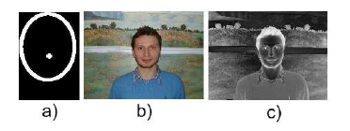
Face Detection
Fig-a shows the face template.
Fig-b shows the face before transformation.
Fig-c shows the face after transformation. Colour different from skin will look lighter & colour similar to skin will look darker.

Slide 16
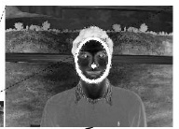
Face Detection
I (sum of the intensities of pixel in T that lie on the boundary of the face template) is small when the template is small.
A sudden increase in I value occur when template lies completely outside the face boundary. This is used to detect the face location. Shown in the adjacent figure.

Slide 17
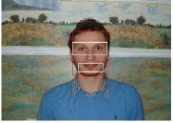
Feature Detection
From homology of human face the rectangular box can be found as in the adjacent figure.
Considering eyes let the box is L_{x} X L_{y} . Say E.
To pin point location of the eyes more accurately.

Slide 18

Feature Detection
To find two l_{x} X l_{y} boxes pin pointing two eyes.
At first edge detection to be performed on left figure which is E.
Right figure will be found and as we approaches the eye more edge will be visible.

Slide 19

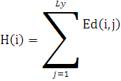
Feature Detection
For each column along the length of E, sum of the edges to be found.
Where 1<=i <= L_{x} and Ed is the image representing the edges in the eye box of size
L_{x} X L_{y} . Peaks are found around the location of the eyes.
Same to be performed on vertical direction but this time summing the edges in each row instead of each column.

Slide 20

Feature Detection
Now to find two equal interval one on each side of the face. Length of the interval is l_{x} .
Here k<=i<=k+l_{x} , is the horizontal edge of the left eye box or right eye box. Depending on where the equation is performed, left or right.

Slide 21
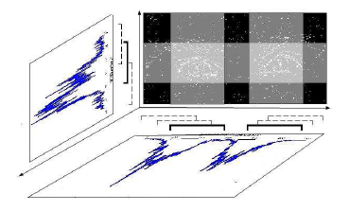
Feature Detection
The horizontal and vertical interval for which the projected area is maximum form the horizontal and vertical edges for the eye box.

Slide 22
Feature Detection
Problem in this process:
eye box E contains region outside of the face so some spike may be observed on either end of the graph H, corresponding to region outside face.
Solution:
multiplying H by a double Gaussian with means around the expected location of the eyes and stander deviation of l_{x} will eliminate this problem.

Slide 23
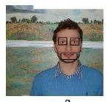
Feature Detection
This will be the final output of the feature detection.
Two eye boxes pin pointing the eyes and same can be there for lips also.

Slide 24
Replacement
Resize eye & the lip boxes belonging to the model face such that they fit their appropriate places in original face, then superimpose them.
This simple replacement will not produce any natural looking face. Further proceeding required.

Slide 25
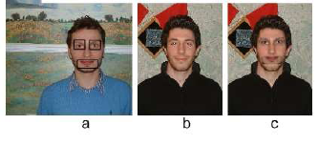
Replacement
Figure a & b are the model & original face respectively.
Figure c gives the result of the replacement which is not looking so natural.

Slide 26
Blending
P( x_{i} , x_{j} ) is the probability that pixel ( x_{i} , x_{j} ) constitutes the eye in the original face.
P(x_{̀i} ʹ, x_{j} ʹ ) is the probability that pixel (x_{̀i} ʹ, x_{j} ʹ ) is part of the desired eye.
Consider both probability distribution function are known.
A new eye box N to be constructed from desired eye box D and original eye box O.

Slide 27
Blending
N(i, j, k)= P( x_{̀i} ʹ, x_{j} ʹ ) D(i, j, k)
+ (1 - P(x_{̀i} ʹ, x_{j} ʹ ))(1 - P( x_{i} , x_{j} )) O(i, j, k)
+ (1 - P(x_{̀i} ʹ, x_{j} ʹ )) P( x_{i} , x_{j} )M_{k}
for k=1,2,3; where N,D,O are all of equal size and M1, M2,M3 are the mean RGB values for the skin colour of the original face.

Slide 28
Blending
When pixel (i,j) in D, D(i,j) is the part of desired eye then N(i,j) must equal the D(i,j).
When pixel (i,j) for which neither D(i,j) nor O(i,j) is a part of D or O then N(i,j) must be equal with the O(i,j). This ensure that the colour and the texture of the original face is preserved.
When pixel (i,j) in D, D(i,j) is not the part of the desired eye but in O, O(i,j) is the part of the original eye then N(i,j) must be same with average skin colour of the original face.

Slide 29
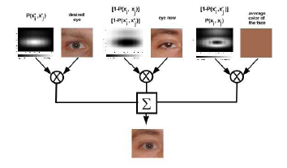
Blending

Slide 30
Blending
Let P( x_{i} ) is the probability that the pixel in the ith row of the original eye box, O, are the eye pixels.
P(x_{j}) is the probability that the pixel in the jth column of the original eye box, O, are the eye pixels.
P(x_{̀i} ʹ) and P(x_{j} ʹ ) are the corresponding probability for the desired eye box D.

Slide 31


Blending

Slide 32
Shifting
Relative position of the eyes in the original eye box, O, and the desired eye box, D, may not be same all the time.
For example, in D eye is present in the top right corner and in O it is present in the bottom left corner.
The expression for the N will then produce the total desired eye in the bottom left corner and the upper right corner will become skin.
This will not look natural.

Slide 33
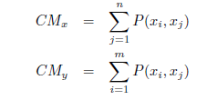
Shifting
Location of the center of the mass of P( x_{i} , x_{j} ) and
P(x_{̀i} ʹ, x_{j} ʹ ) to determine where the eyes are located in O & D.
Let x & y coordinate of the center of mass, CM_{x}, CM_{y} for a given PDF could be found in this way.

Slide 34
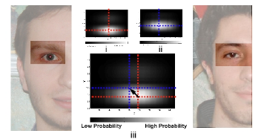
Shifting
In the adjacent figure eye in the desired eye box is shifted in the location same as in the original eye box.

Slide 35
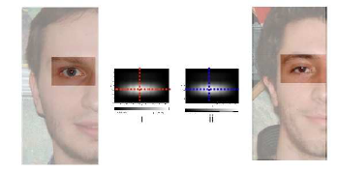
Shifting
Here the eye boxes are translated. Both of the eye box will be located in the relatively same position.

Slide 36
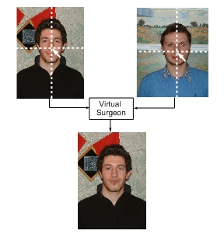
Conclusion
Figure a is the original face.
Figure b is the model face.
Figure c gives the final face where the improvement gains due to the application of blending & shifting after replacement.

Slide 37
References
[1] Goin MK, Rees TD, A prospective study of patients' psychological reactions to rhinoplasty, An- nals of Plast Surgery, 27(3):210{5, Sep 1991.
[2] Luboz V, Chabanas M, Swider P, Payan Y. Orbital and maxillofacial computer aided surgery 1997 , 8(4):259- 65, Aug 2005.
[3] Yamada T, Mori Y, Minami K, Mishima K, Sugahara T, Sakuda M., Computer aided threedimensional analysis of nostril forms ; 27(6):345{53, Dec 1999.
[4] Aarabi, P., Hughes, D., Mohajer, K., Emami, M., The Automatic Measurement of Beauty, Proceedings of the IEEE International Conference on Systems, Man, and Cybernetics 2001 , October 2001.
[5] Hjelmas E., Face Detection: A Survey, Computer Vision and Image Understanding,, 83(3):236{274, Sept. 2001.
[6] Gonzalez R. Woods . E., Digital Image Processing, Prentice Hall, Second Edition, 2002.
[7] Smith A. R., Color gamut transform pairs, Computer and Graphics, (3): 12-19, 1978.
[8] J.M.S. Prewitt, Object enhancement and extraction in picture Processing and Pcychopictorics, B.S. Liplin and A. Rosenfeld, Eds. New York, Academic Press, 1970.
[9] A. Desilva K. Aizawa, Detection and tracking of facial features by using a facial feature model and deformable circular template, IEICE Trans. Inform. Systems, 1995 , (9): 1195-1207, 1995.
[10] C. Kotropoulos I. Pitas, Rule-based face detection in frontal views, Proceedings of the International Conference on Acoustics, Speech, and Signal Processing, 1997 , (4): 2537{2540, 1997.
[9] M.J. Jones and J.M. Rehg, Statistical Color Models with Application to Skin Detection, Proceedings of IEEE Conference on Computer Vision and Pattern Recognition, 1999 , 274{280, 1999.

Slide 38
Thank You…

